Slide 1
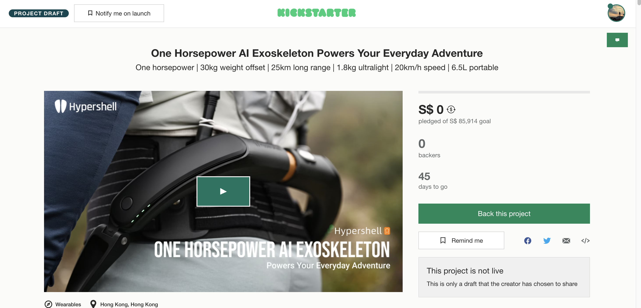
1 HP Output | 30KG Weight Offset | 25KM Long Range | 1.8KG Ultralight | 20KMH Speed | 6.5L Size
首图上的HS logo重复出现了两次，建议调整
Hypershell or HyperShell? S大小写需要确认统一，后面也是同样

Slide 2
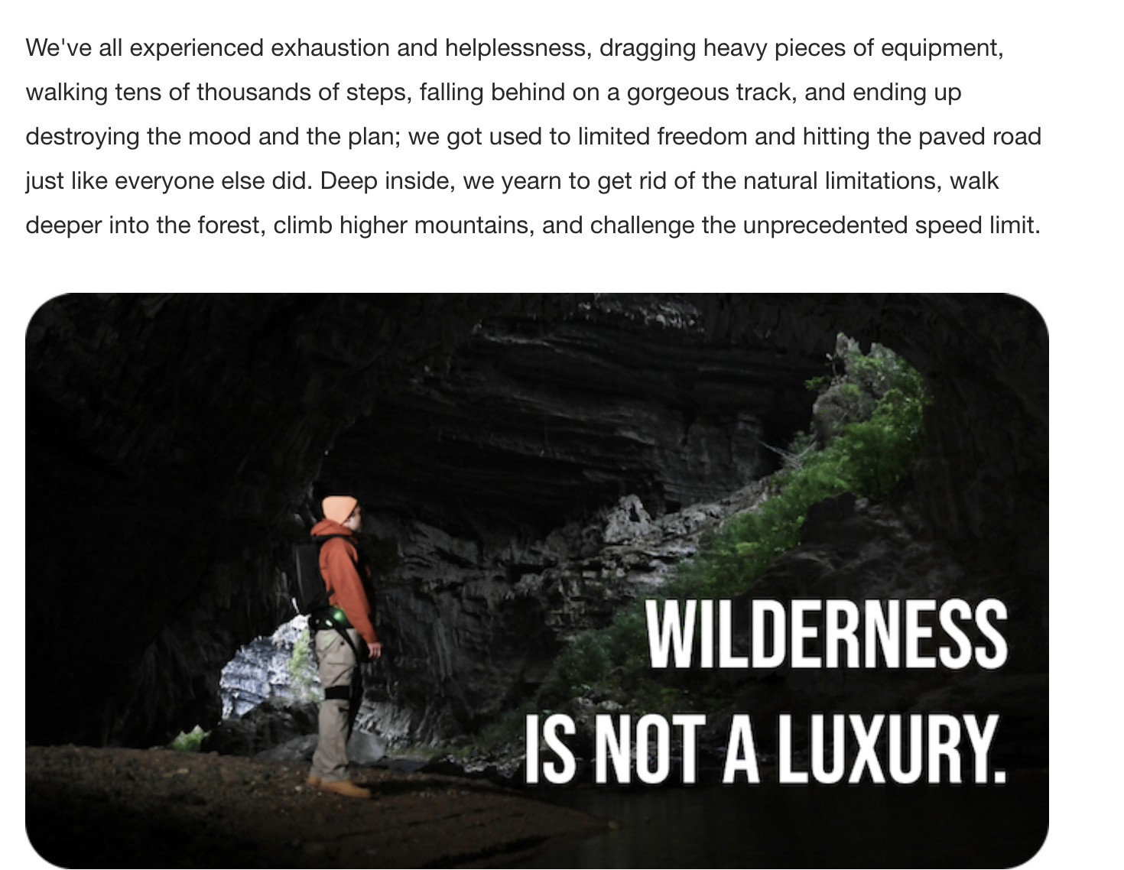
Speed limit改成speed limits
这张探洞图，有没有同样角度画面，男模更仰头的照片?有的话换成抬头的

Slide 3
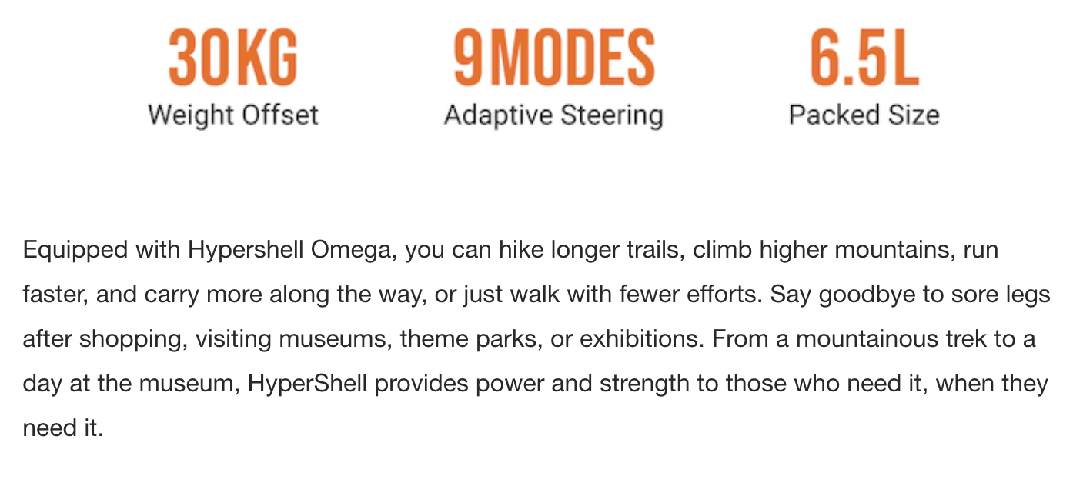
Equipped with Hypershell Omega, you can hike longer trails, climb higher mountains, run faster, and carry more along the way, or simply walk with less effort. Say goodbye to sore legs after shopping, visiting museums, theme parks, and exhibitions. From a mountainous trek to a day at the museum, Hypershell provides power and strength to those who need it, when they need it.

Slide 4
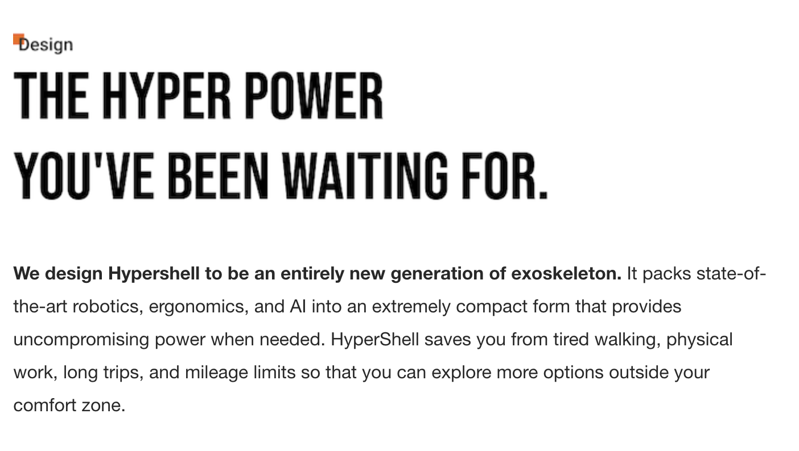
We design Hypershell to be an entirely new generation of the exoskeleton. It packs state-of-the-art robotics, ergonomics, and AI into an extremely compact form that provides uncompromising power when needed. Hypershell saves you from tired walking, physical work, long trips, and mileage limits so that you can explore more options outside your comfort zone.

Slide 5
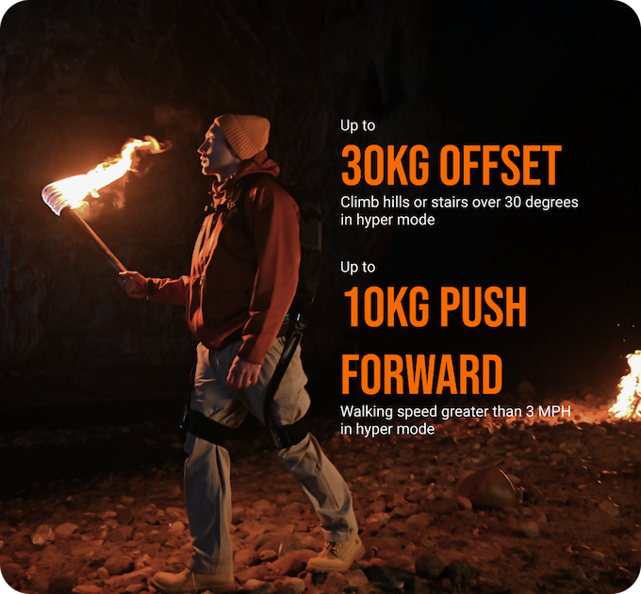
30度还是60度
30KG OFFSET
VERTICAL
In hyper mode去掉，末尾加*
10KG PUSH
HORIZONTAL
In hyper mode去掉，末尾加*
*Results were returned in hyper mode at test environment.
加一行测试条件小字，例如
*Results were returned in hyper mode at test environment.
缩进未对齐

Slide 6
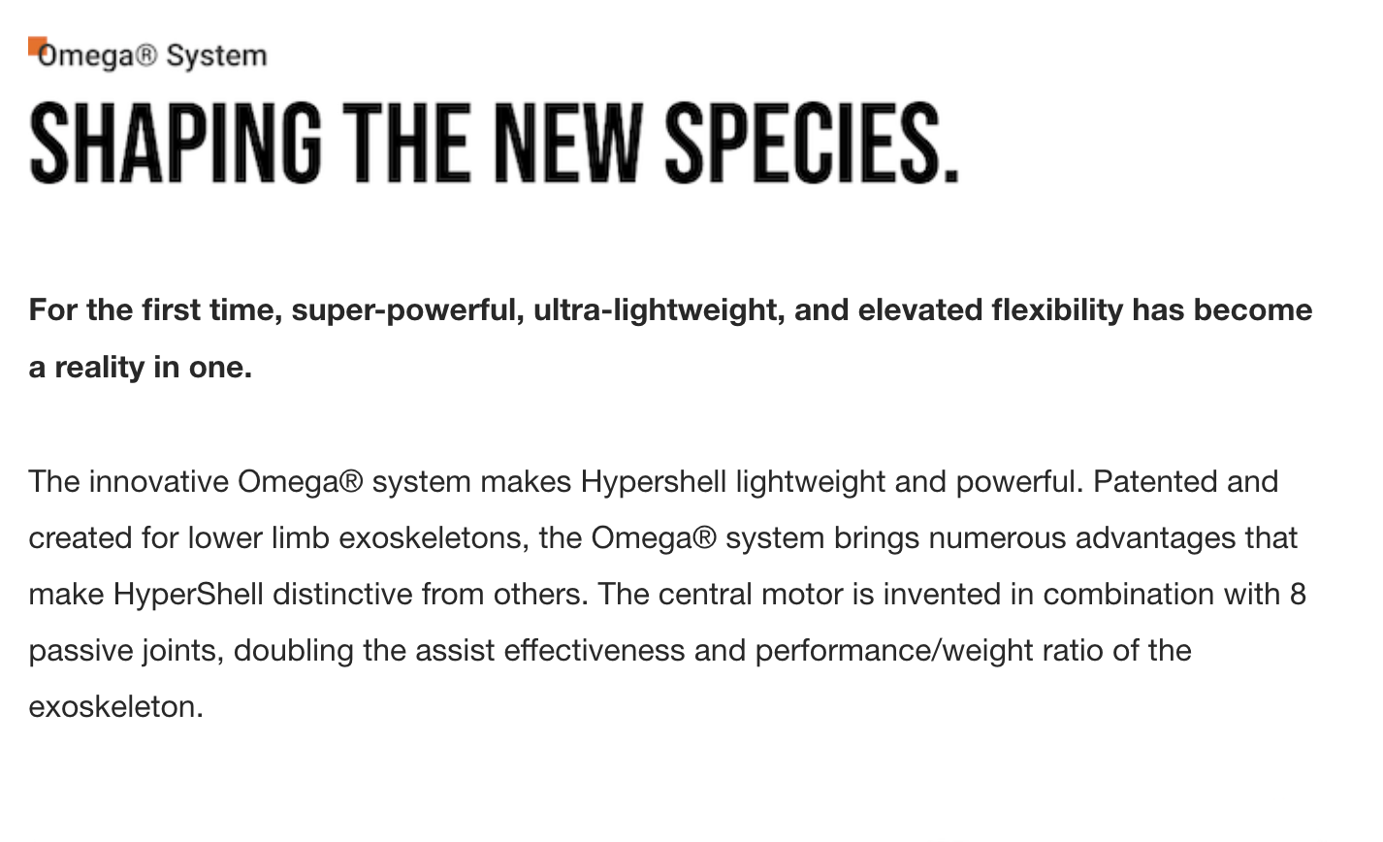
For the first time, super-powerful, ultra-lightweight, and elevated flexibility has become a reality in one.
The innovative Omega® system makes Hypershell lightweight and powerful. Patented and created for lower limb exoskeletons, the Omega® system brings numerous advantages that make HyperShell distinctive. The central motor is invented in combination with eight passive joints, doubling the assist effectiveness and performance/weight ratio of the exoskeleton.

Slide 7
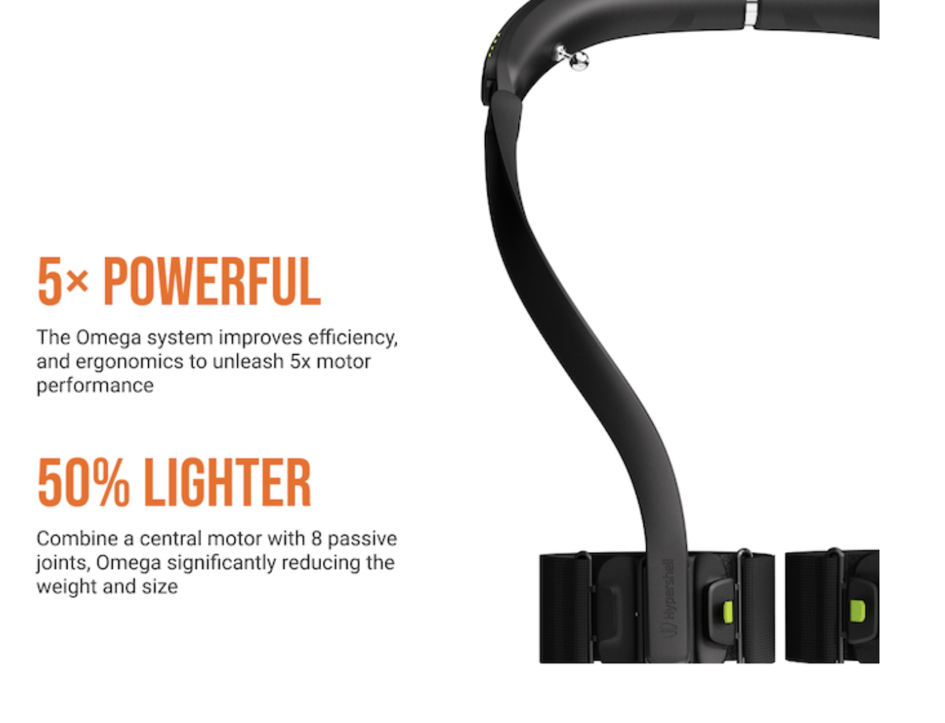
5X
Omega® system
Combining
the Omega® system
reduces

Slide 8
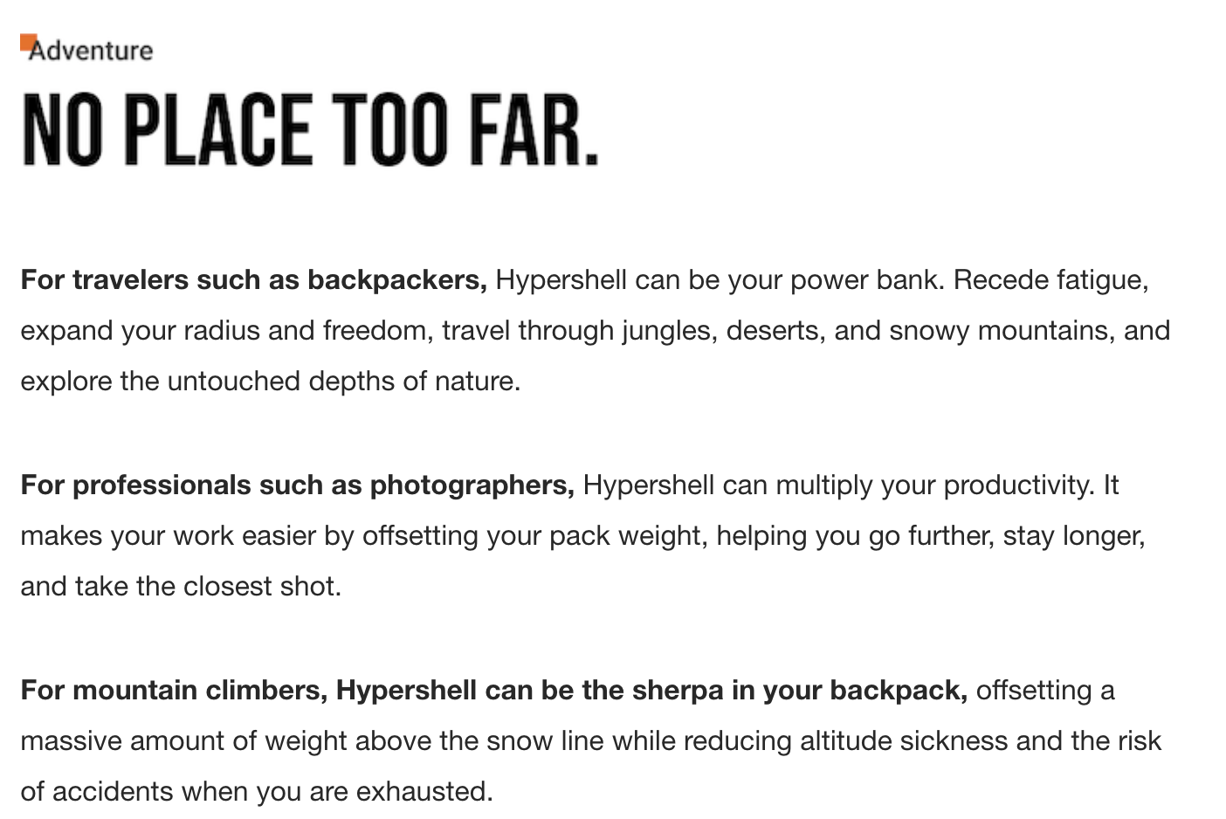
For travelers and backpackers, Hypershell can be your power bank of endurance. Recede fatigue, expand your radius and freedom, travel through jungles, deserts, and snowy mountains, and explore the untouched depths of nature.
For professionals such as photographers, Hypershell can multiply your productivity. It makes your work easier by offsetting your pack weight, helping you go further, stay longer onsite, and take the closest shot.
For mountain climbers, Hypershell can be the sherpa in your backpack, offsetting a massive amount of weight above the snow line while reducing altitude sickness and the risk of accidents when you are exhausted.

Slide 9
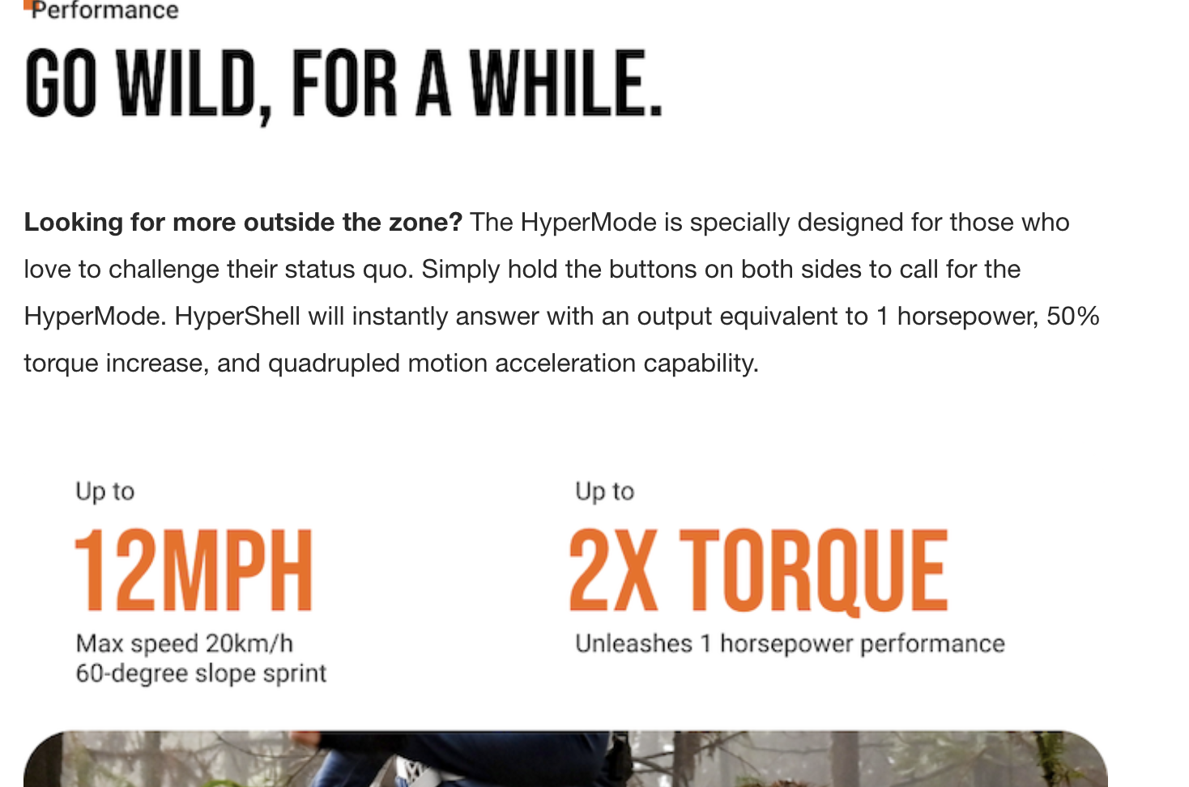
Powering Your Everyday Adventure
Looking for more outside the zone? The Hyper Mode is designed for those who love challenging their status quo. Simply hold the buttons on both sides to call for Hyper Mode. Hypershell will instantly answer with an output equivalent to 1 horsepower, 50% torque increase, and quadrupled motion acceleration capability.
With 1 hp peak power output
At the same time, the AI Motion Engine inside Hypershell will act more aggressively, boosting reaction frequency from 1000Hz to 3000Hz. This brings an added max running speed of 20km/h, a 60-degree slope sprint, a steady 30kg weight offset, and 10kg of horizontal thrust to make a history of your own.

Slide 10
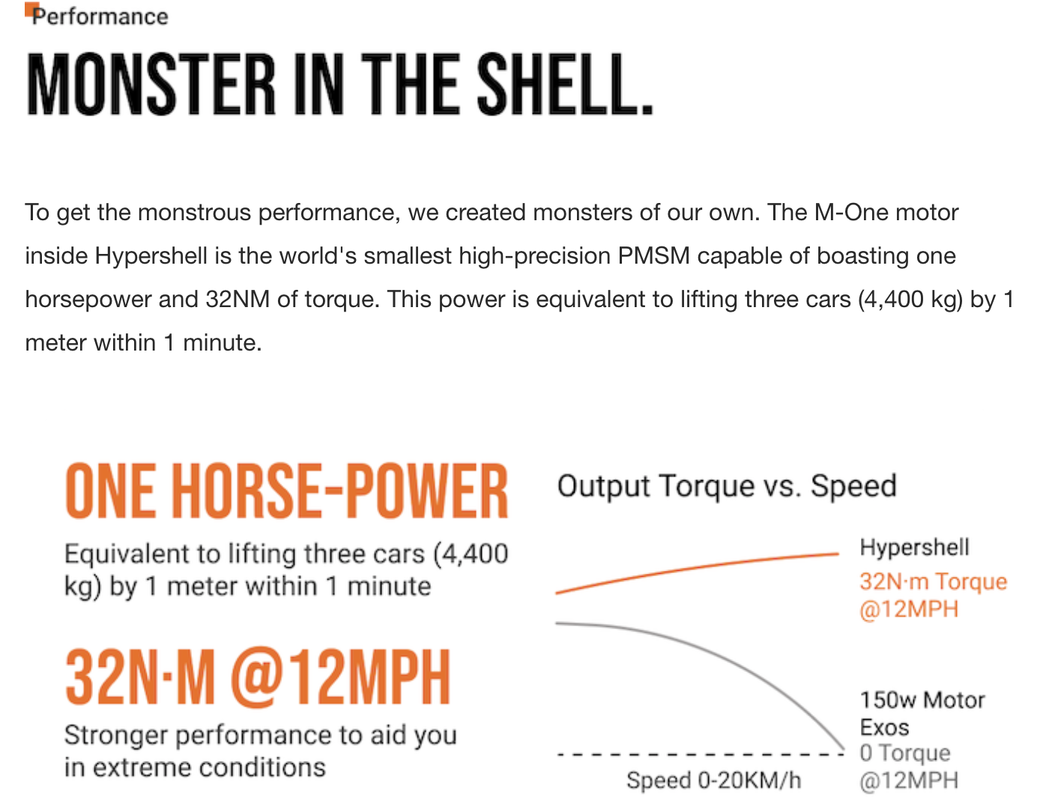
1改成a
W大写
150W Exos
50还是150W
To get the monstrous performance, we created monsters of our own. The M-One motor inside Hypershell is the world's smallest high-precision Permanent Magnet Synchronous Motor (PMSM), capable of boasting one horsepower and 32NM of torque. This power is equivalent to lifting three cars (4,400 kg) by 1 meter within a minute.
Unlike the market wearable exoskeletons with 50W motors, Hypershell demands stronger performance to aid you in extreme sports. The M-One motor is specially developed for high-performance wearable robots. It is highly integrated, ultra-lightweight, high-precision, and provides astoundingly strong power.

Slide 11
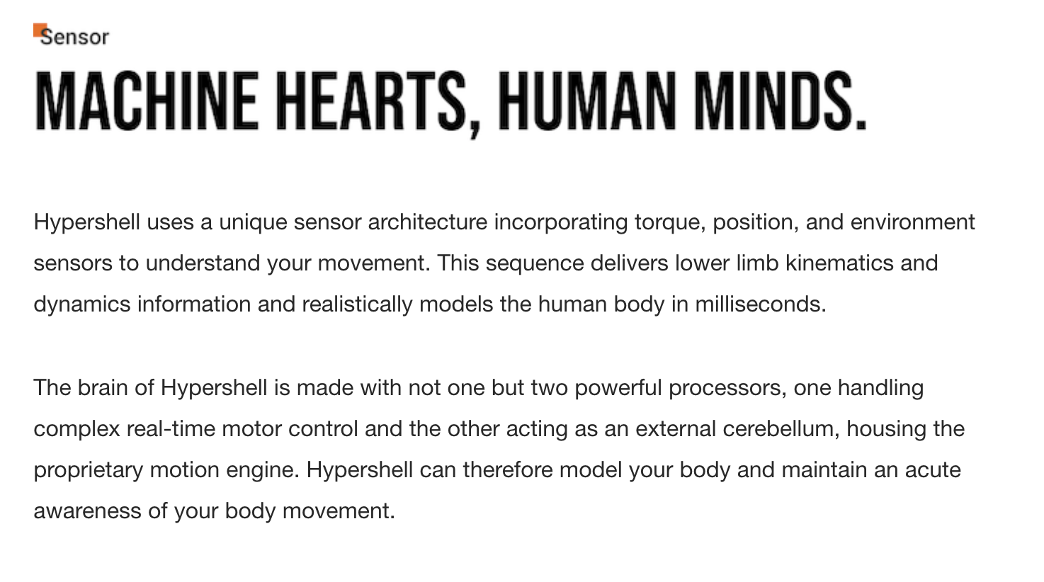
Hypershell uses a unique sensor architecture incorporating torque, position, and environment sensors to understand your movement. This sequence delivers lower limb kinematics and dynamics information and realistically models the human body in milliseconds.
The brain of Hypershell is made with not one but two powerful processors, one handling complex real-time motor control and the other acting as an external cerebellum, housing the proprietary motion engine. Hypershell can therefore model your body and maintain an acute awareness of your body movement.

Slide 12
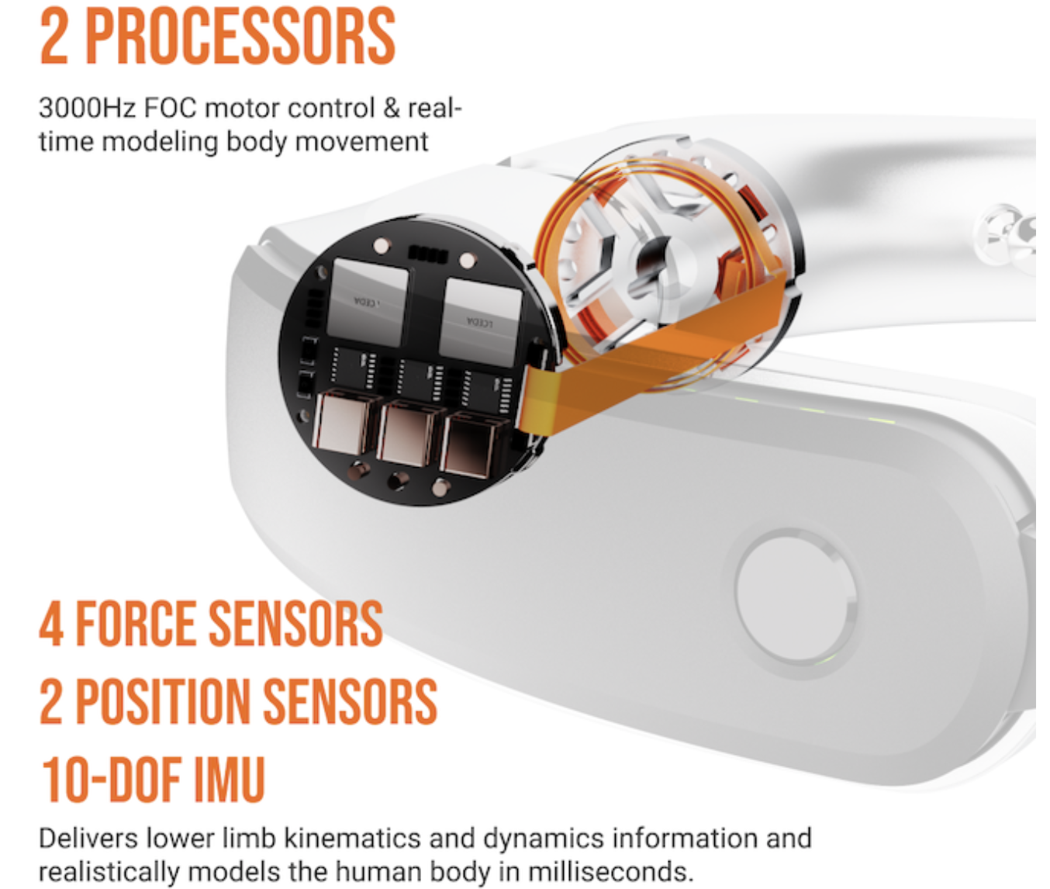
2X，下面4X，2X同理
缩进没对齐

Slide 13
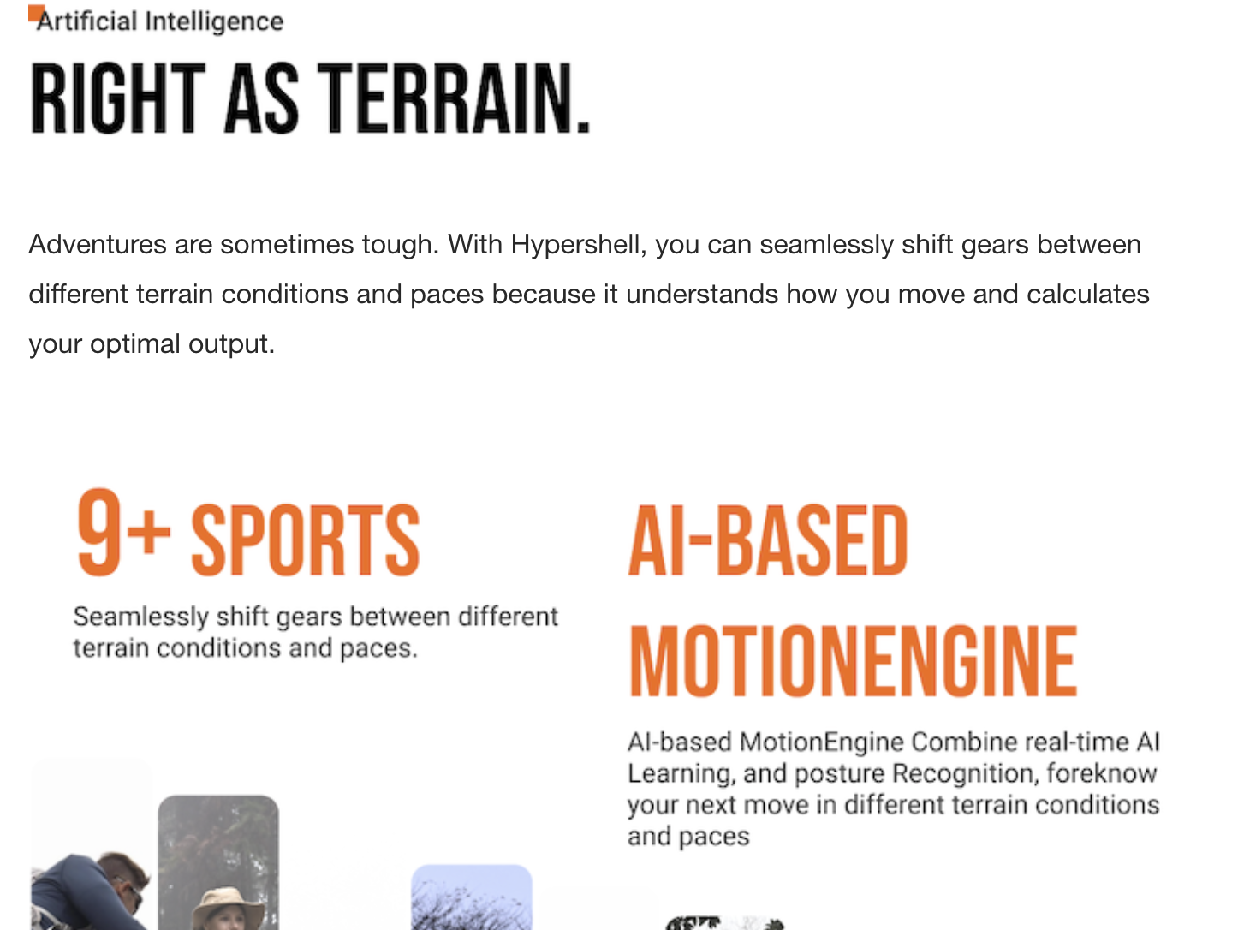
SPORTS改成MODES
MOTION ENGINE
直接以Combines开头，
Foreknow改成foreknows
Adventures are sometimes tough. With Hypershell, you can seamlessly shift gears between different terrain conditions and paces because it understands how you move and calculates your optimal output. Easily move through the day with an AI Motion Engine that adapts to over nine sports modes, including walking, race walking, running, riding, climbing, up/down stairs, up/down hills, gravel road, and auto hold.
The MotionEngine technology utilizes AAF (Automatic Adaptive Force) algorithms based on deep learning models to foreknow your next move. Simulation technology and extensive data training generated by Human-in-the-Loop allow the MotionEngine to handle a variety of complex terrains intelligently. Hypershell will actively learn and adapt to your motion habits as you spend more time using it. Take the first step, and leave the rest to Hypershell.

Slide 14
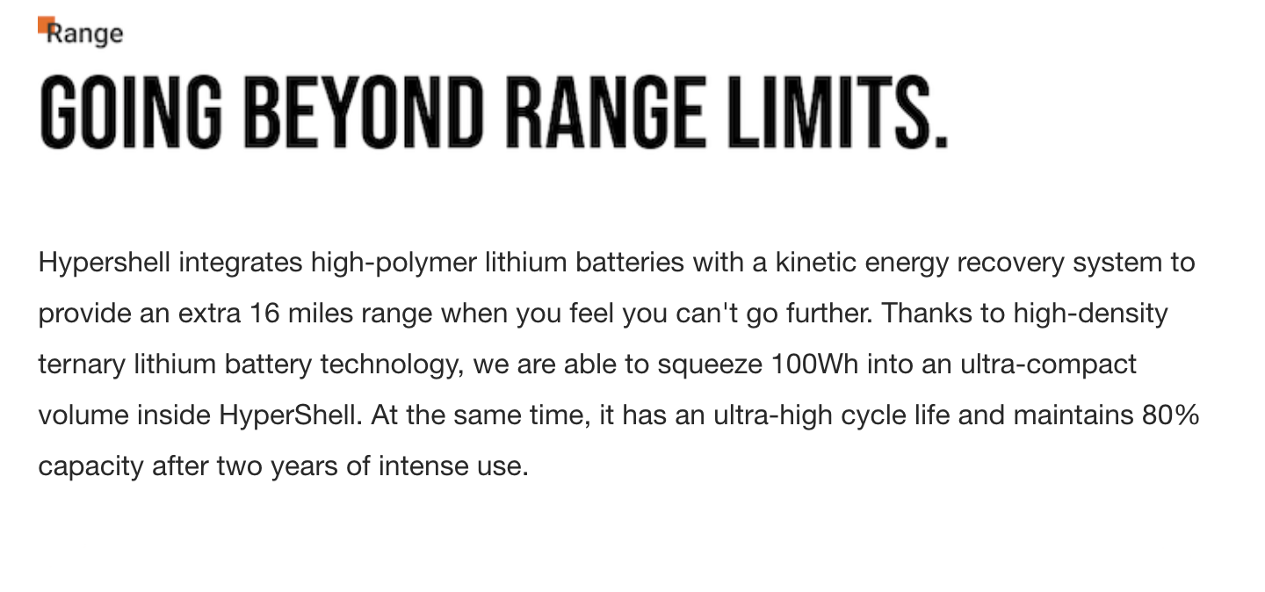
Hypershell integrates high-polymer lithium batteries with a kinetic energy recovery system to provide an extra 16 miles range when you feel you can't go further. Thanks to high-density ternary lithium battery technology, we are able to squeeze 100Wh into an ultra-compact volume inside Hypershell. At the same time, it has an ultra-high cycle life and maintains 80% capacity after two years of intense use.

Slide 15
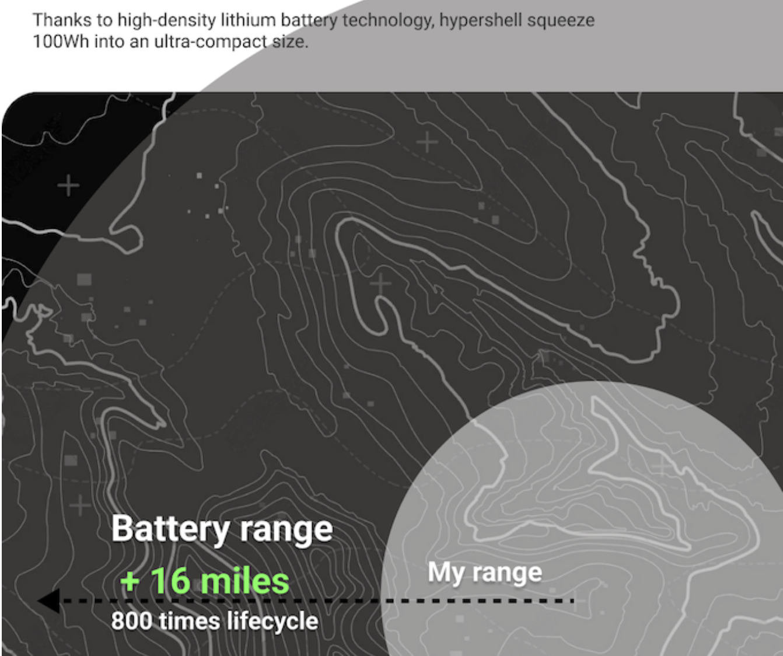
Squeeze改成packs
800 times lifecycle 改成 800+ cycles

Slide 16
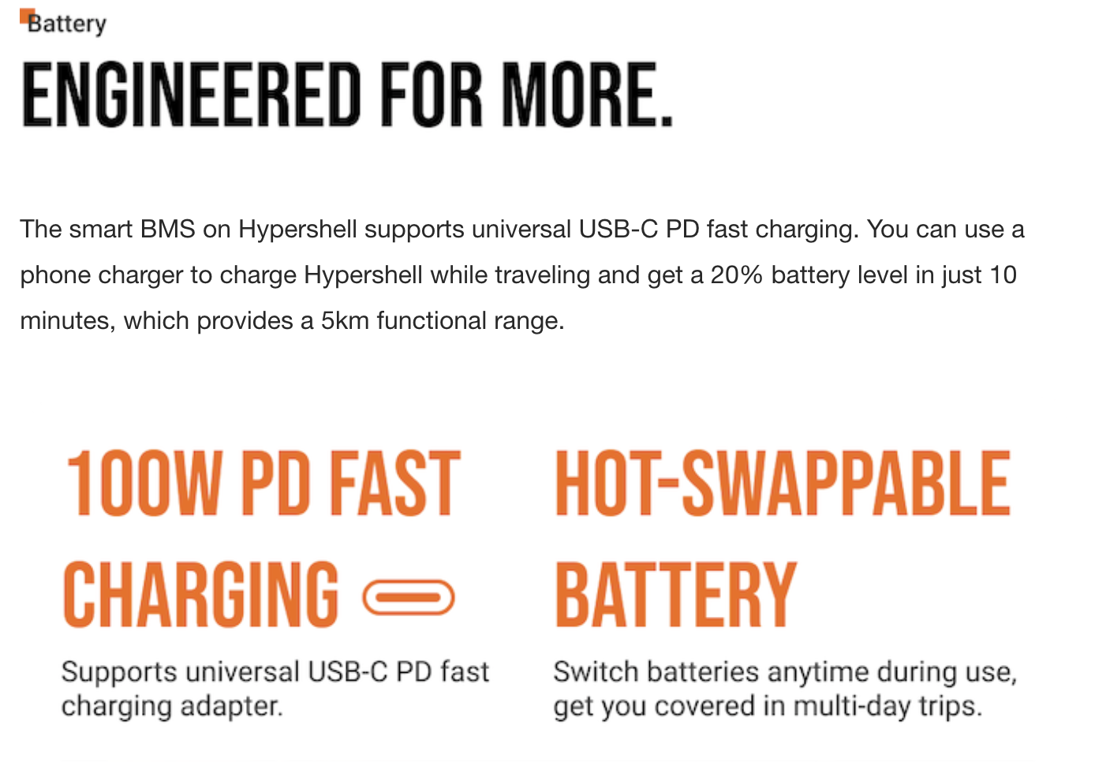
Supports universal USB-C PD fast charging adapter up to 100W.
The smart battery management system (BMS) on Hypershell supports universal USB-C PD fast charging. You can use a phone charger to charge Hypershell while traveling and get a 20% battery level in just 10 minutes, which provides a 5km functional range.
Hypershell can get you covered even in multi-day hiking or long trips. The hot-swappable battery design on both sides of Hypershell is compatible with a mixture of new and used batteries, so you can switch batteries anytime during use.

Slide 17
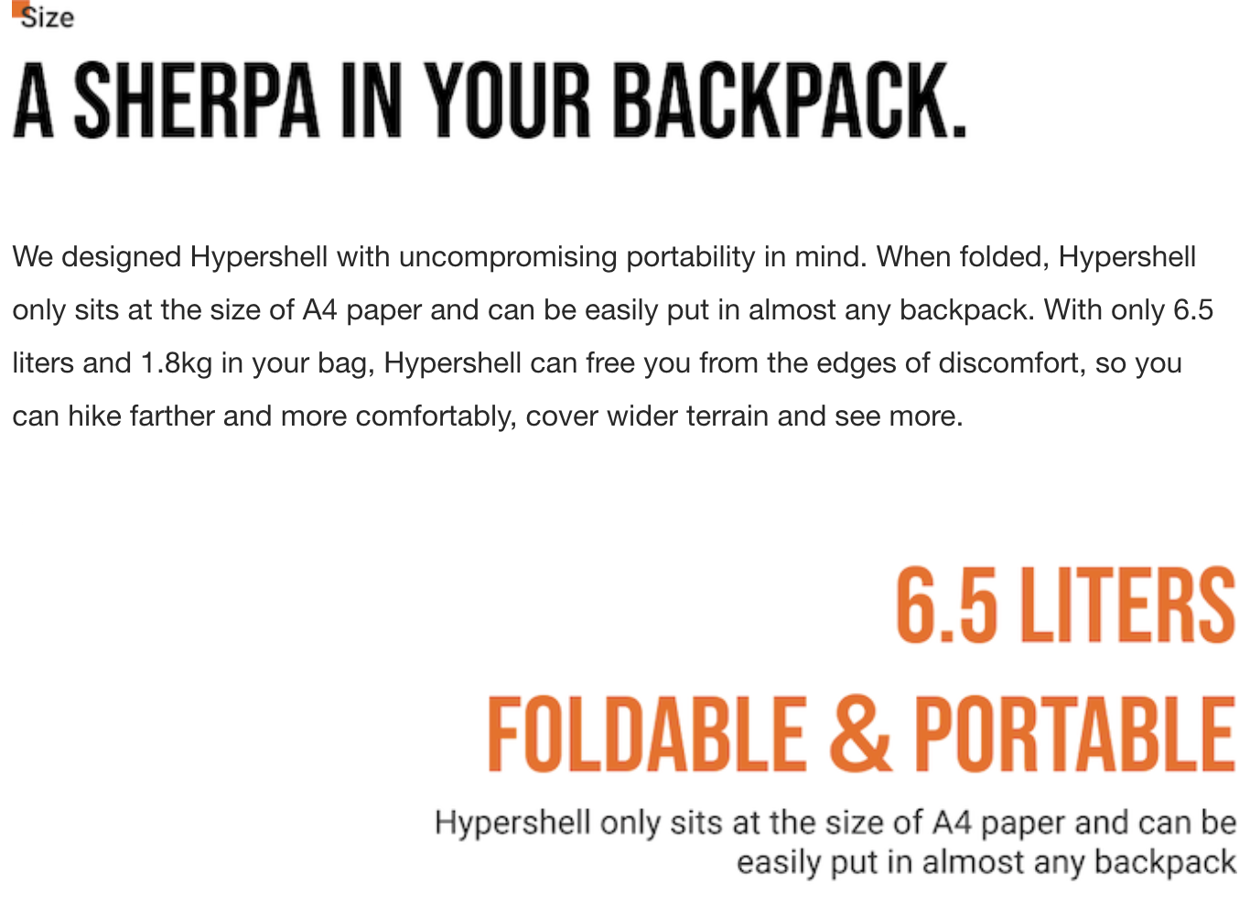
We designed Hypershell with uncompromising portability in mind. When folded, Hypershell only sits at the size of A4 paper and can be easily put in almost any backpack. With only 6.5 liters and 1.8kg in your bag, Hypershell can free you from the edges of discomfort, so you can hike farther and more comfortably, cover wider terrain and see more.

Slide 18
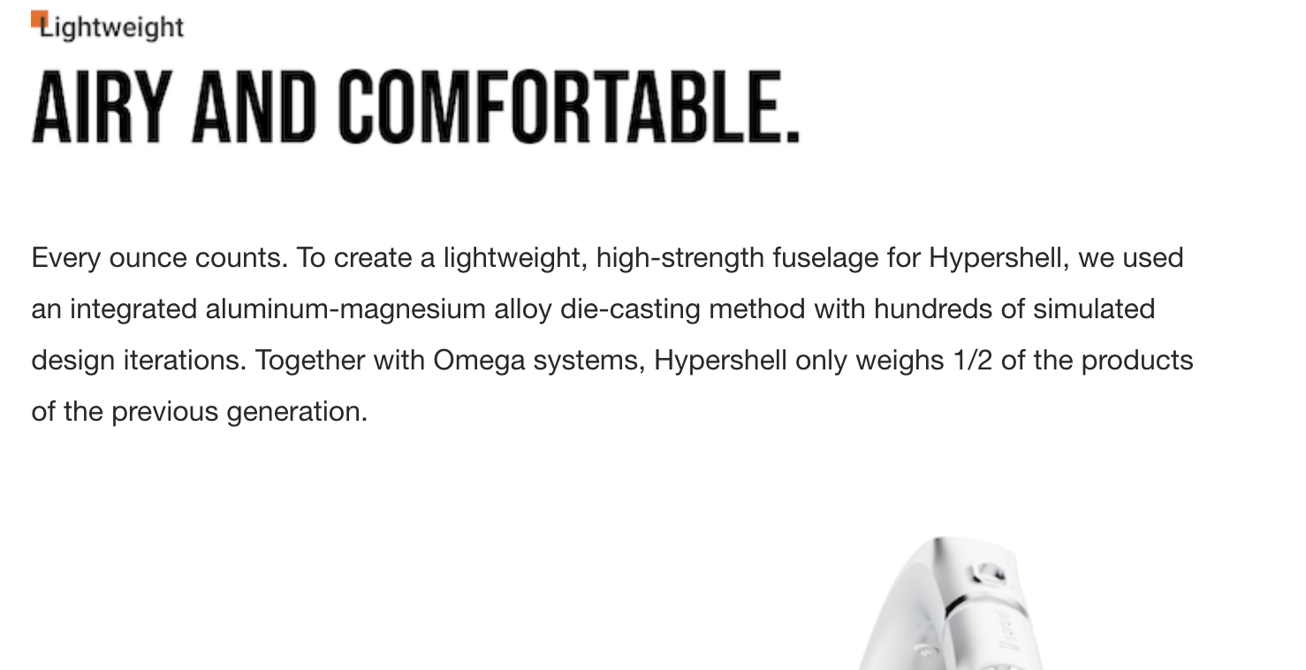
Every ounce counts. To create a lightweight, high-strength fuselage for Hypershell, we used an integrated aluminum-magnesium alloy die-casting method with hundreds of simulated design iterations. Together with Omega systems, Hypershell only weighs 1/2 of the products of the previous generation.

Slide 19
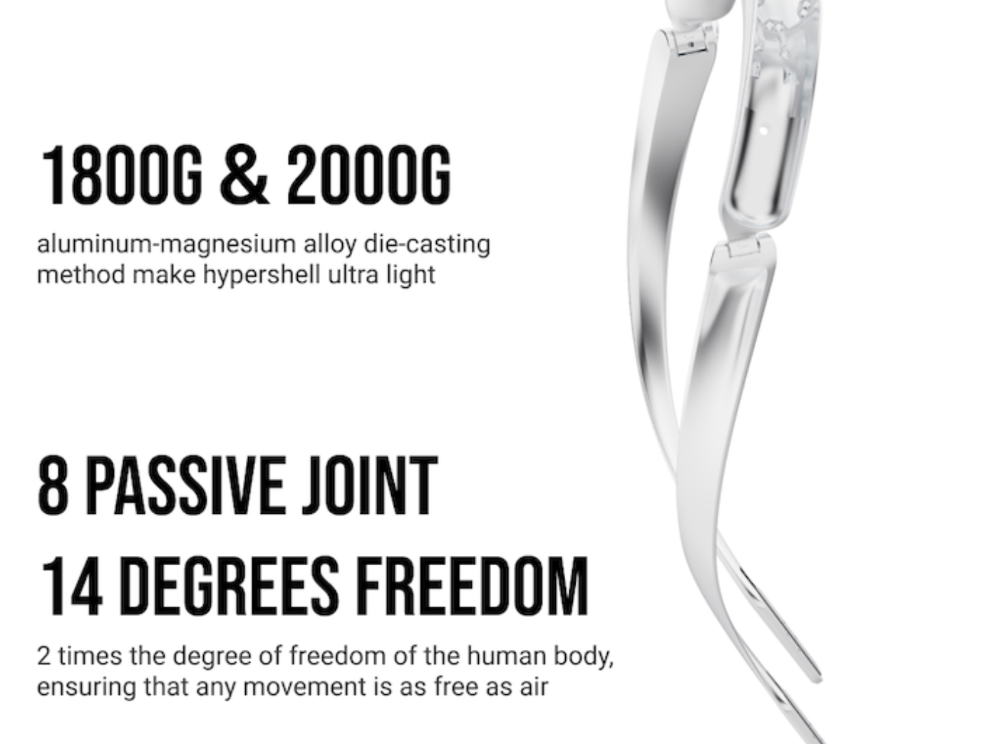
双数据意义不明，建议仅保留1800 GRAMS
8 JOINTS
14 DOF

Slide 20
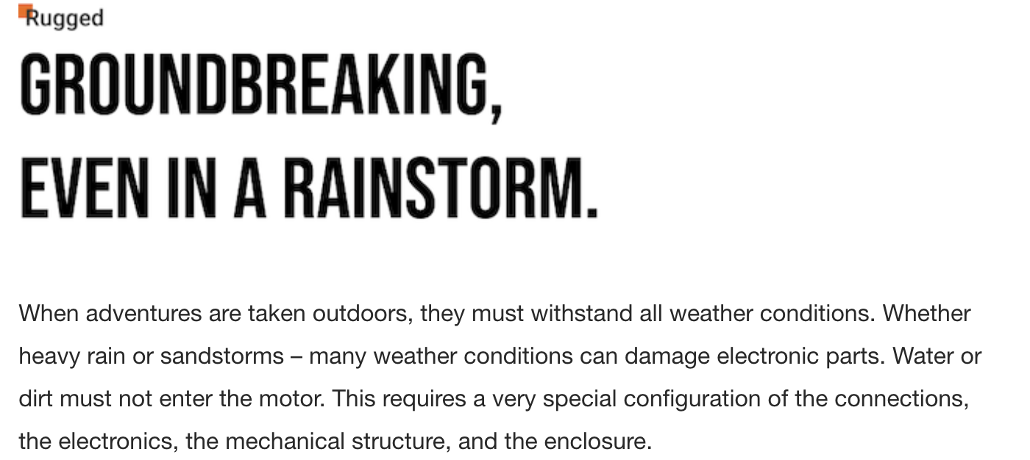
改成Ruggedness
When adventures are taken outdoors, they must withstand all weather conditions. Whether heavy rain or sandstorms – many weather conditions can damage electronic parts. Water or dirt must not enter the motor. This requires a very special configuration of the connections, the electronics, the mechanical structure, and the enclosure.
Hypershell has gone to great lengths to make weatherproof products and offers these features: waterproof screw connections, specially coated circuit boards, weatherproof aluminum enclosures, and polyurethane coatings including UV protection. This ensures optimum protection of the product at all times. The weatherproof-certified products of Hypershell comply with protection class IP54 according to IEC 529 / EN 60529.

Slide 21
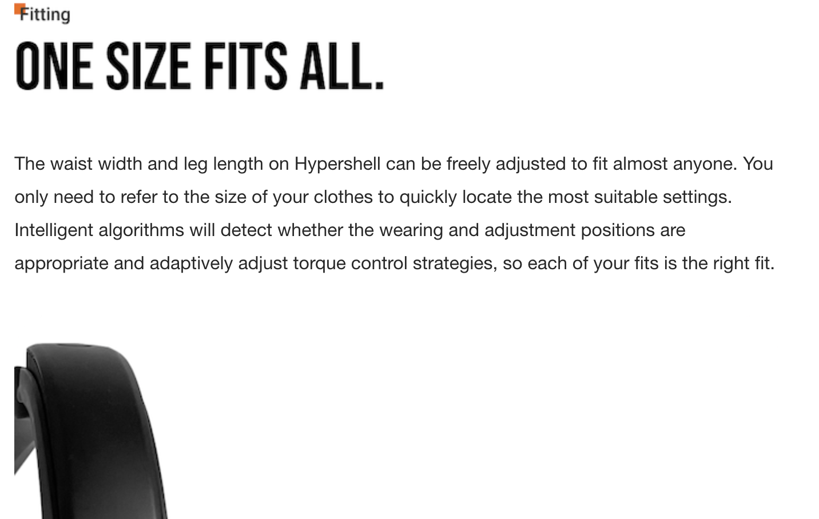
The waist width and leg length on Hypershell can be freely adjusted to fit almost anyone. You only need to refer to the size of your clothes to locate the most suitable settings quickly. Intelligent algorithms will detect whether the wearing and adjustment positions are appropriate and adaptively adjust torque control strategies, so each of your fits is the right fit.

Slide 22
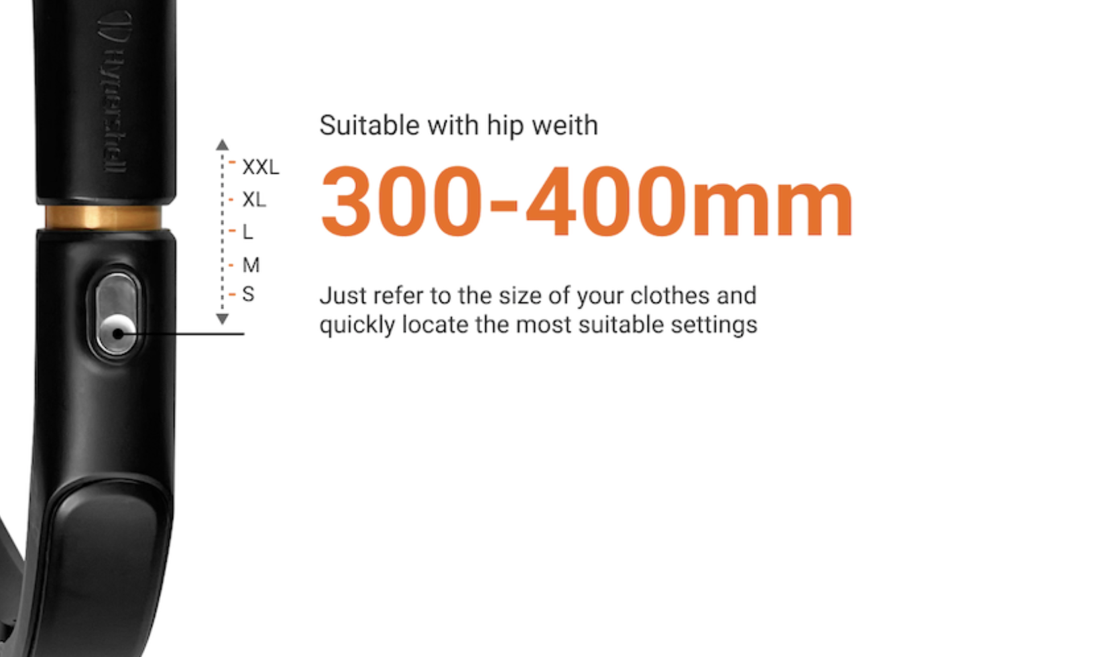
Hip width
Find the good fit with your clothing sizes

Slide 23
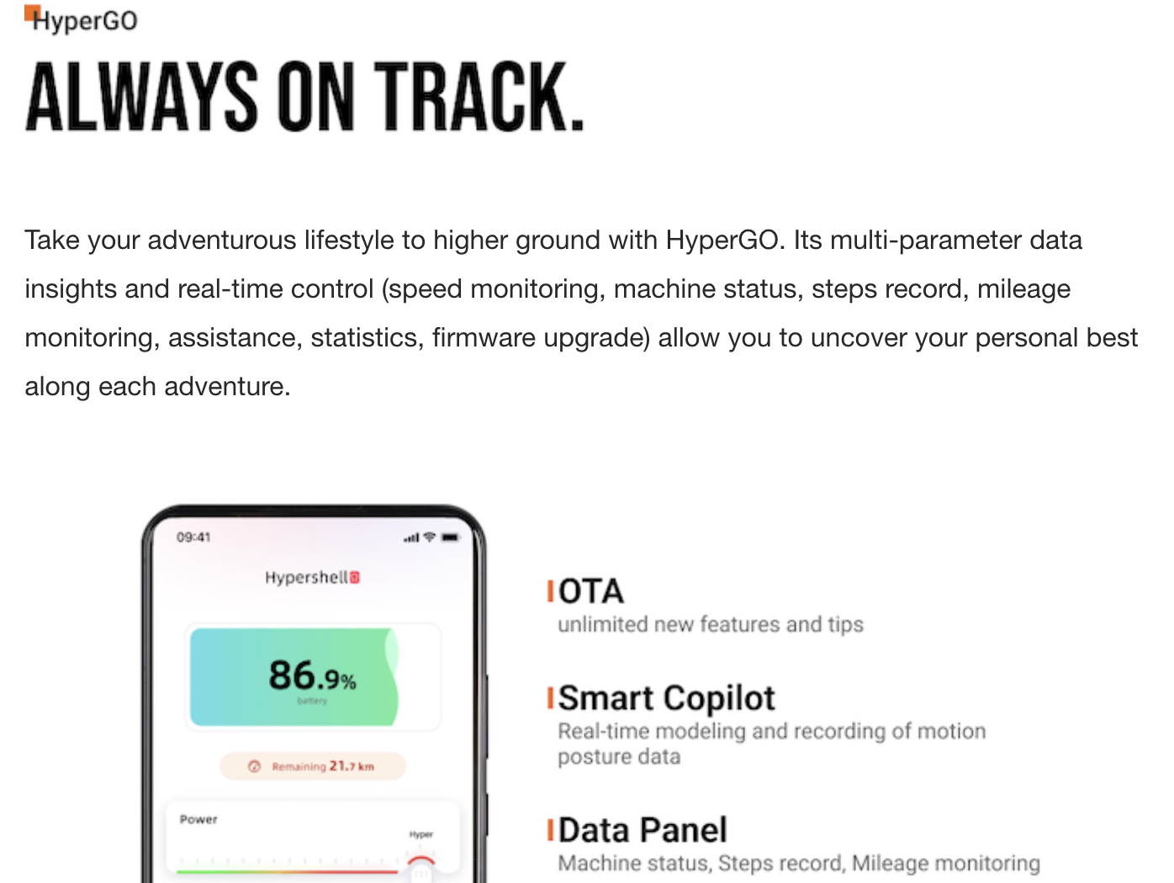
Hip width
Find the good fit with your clothing sizes
Take your adventurous lifestyle to higher ground with HyperGO. Its multi-parameter data insights and real-time control (speed monitoring, machine status, steps record, mileage monitoring, assistance, statistics, firmware upgrade) allow you to uncover your personal best along each adventure.

Slide 24
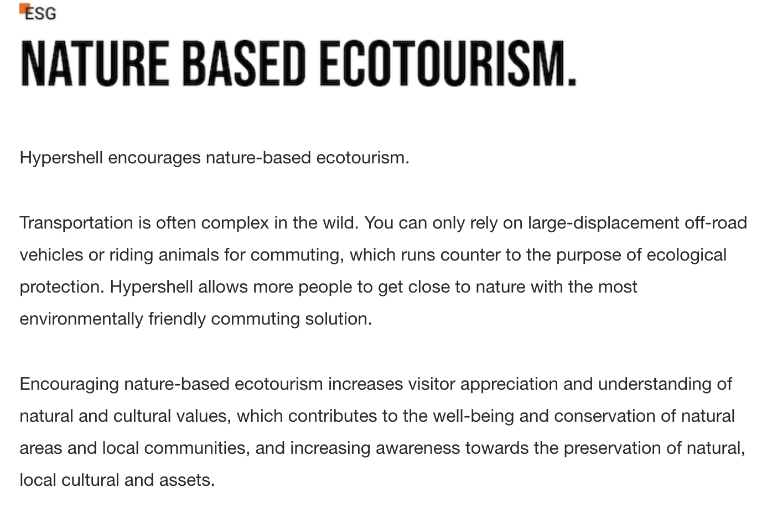
At Hypershell, we encourage nature-based ecotourism.
Transportation is often complex in the wild. You can only rely on large-displacement off-road vehicles or riding animals for commuting, which runs counter to the purpose of ecological protection. Hypershell allows more people to get close to nature with the most eco-friendly commuting solution.
Encouraging nature-based ecotourism increases visitor appreciation and understanding of natural and cultural values, contributes to the well-being and conservation of natural areas and local communities, and raises awareness towards preserving genuine local culture and assets.

Slide 25
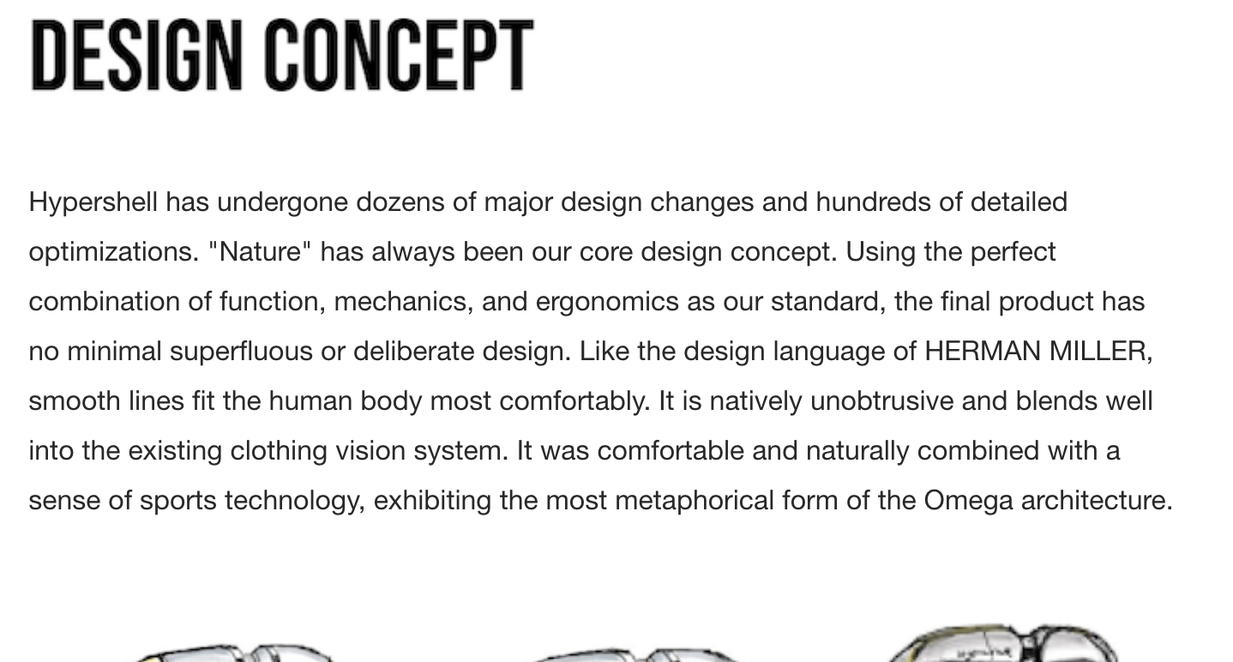
Hypershell has undergone dozens of significant design modifications and hundreds of optimizations. "Nature" has always been our core design concept. Using the perfect combination of function, mechanics, and ergonomics as our standard, the final product has no minimal superfluous or deliberate design. Like the design language of HERMAN MILLER, smooth lines fit the human body most comfortably. It is natively unobtrusive and blends well into the existing clothing vision system. It was comfortable and naturally combined with a sense of sports technology, exhibiting the most metaphorical form of the Omega architecture.

Slide 26
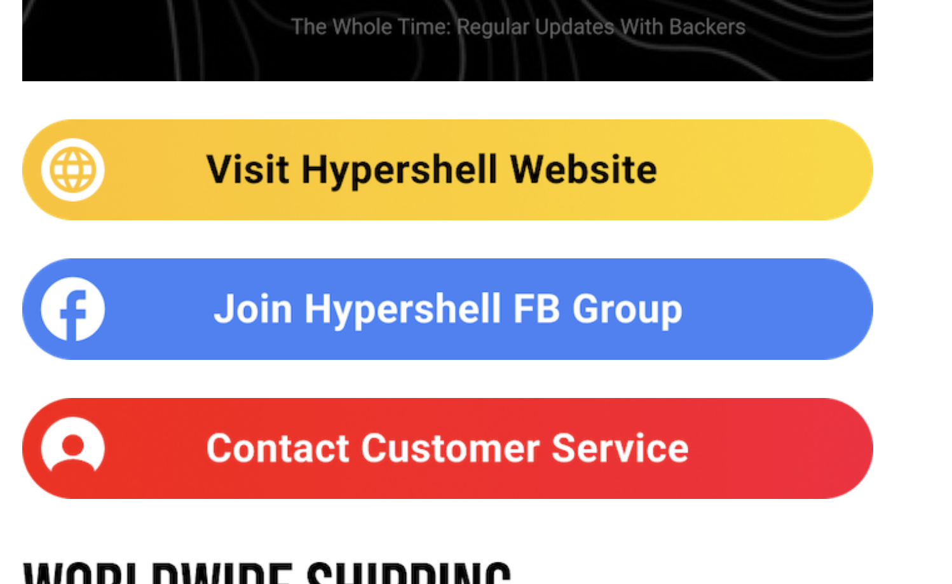
加一个绿色BAR，Get the Hypershell Media Kit

Slide 27
SHIPPING
Because international shipping rates are so elevated, we've decided not to charge shipping fees on Kickstarter right now but to charge them when we're closer to shipping.
We have worked with many shipping companies to get the best rates for shipping worldwide, and container shipping is by far the best rate. We will continue to work with shipping companies, and if we find a better price, we will change our service. In the meantime, we are offering a significant discount from our original plan to compensate for the higher shipping costs.
Because Hypershell is relatively small and lightweight compared to traditional exoskeletons, we expect shipping prices to be $30-40 per board for most parts of the world. Depending on the country, the most expensive areas should be around $60 per board. Hypershell is committed to covering any excess over $40.
You'll be pledging without shipping on Kickstarter, but know that this will be taken care of around June when we start fulfillment. Thank you for your comprehension.

Slide 28
Risks and challenges
We have worked very hard to prepare for the Kickstarter launch and to manufacture and fulfill this product, but here are the risks we see and our plan to evaluate them:
Manufacturing.
The manufacturer is lined up, and we have quality assurance people on-site during production.
Fulfillment.
Sometimes things get a little crazy, and things happen that can't be planned for: suppliers missing deadlines, customs clearance, or lost shipments. These things can lead to delays.
We are using an experienced logistics team to deliver our products to you. We will maintain open and honest communication through our processes, so you know where your product is and when it will reach you.

Slide 29
Environmental commitments
Visit our Environmental Resources Center to learn how Kickstarter encourages sustainable practices.
Long-lasting design
The estimated lifetime of Hypershell Omega is five years, given its durable and long-lasting materials. The entire product uses a corrosion-resistant aluminum alloy.
Reusability and recyclability
Hypershell uses rechargeable and replaceable 18650 lithium batteries with a charge cycle of over 800 times. Also, the process from production to recycling lithium batteries will not produce heavy mental pollution.
Sustainable materials
We will use environmentally friendly cardboard boxes as packing boxes and courier boxes as packaging.
Sustainable Distribution
Hypershell will use environmentally friendly cardboard boxes as packing boxes and courier boxes as packaging.

